Slide 1

RhythmRestore: A Smart System for Circadian Balance and Sleep Wellness IOMP IT-25-04
Dr.CH.Prem Kumar
(Internal Supervisor)
-By
M.MEGHA REDDY(22261A1238)
ROHAN SIDHARTH(22261A1250)

Slide 2

MAHATMA GANDHI INSTITUTE OF TECHNOLOGY(A)
DEPARTMENT OF INFORMATION TECHNOLOGY
An Industry Oriented Mini Project(IT653PC)
On
RHYTHM RESTORE
By
Mahareddy Megha Reddy(22261A1238)
Rohan Sidhratrh(22261A1250) Batch ID: IT-24-04
Internal Supervisor
Dr.CH.PremKumar Professor
IOMP Supervisor
Mrs.U.Chaitanya
Assistant Professor

Slide 3
OUTLINE
ABSTRACT
INTRODUCTION
EXISTING SYSTEM
PROPOSED SYSTEM
APPLICATIONS
REQUIREMENTS
LITERATURE SURVERY
PROBLEM STATEMENT
OBJECTIVES
MODULES DESCRIPTION
ALGORITHM
DESIGN
CODE EXECUTION / RESULT
TEST CASES
CONCLUSION AND FUTURE ENHANCEMENT
REFERENCES

Slide 4
ABSTRACT
RhythmRestore is an AI-powered wellness system designed to help users maintain a healthy circadian rhythm by monitoring their sleep patterns, mood fluctuations, and daily lifestyle habits. It aims to address common disruptions like stress, overwork, irregular sleep, and emotional imbalance that can lead to mental health issues, including dissociative symptoms.
The system takes user inputs such as sleep duration, mood states (anger, stress, hunger), skipped meals, workload, and environmental stressors like traffic or negative social interactions. Using intelligent algorithms and cybernetic health principles, it analyzes this data to detect circadian rhythm imbalances and predict their potential impact on mental and physical well-being.
RhythmRestore then offers personalized, doctor-verified recommendations to restore balance. These include dietary tips, meditation, hot baths, screen-time control, and stress-relief techniques—all designed to be culturally relevant, affordable, and effective for Indian users.
Users receive these suggestions through a mobile-friendly web application. By promoting early detection and self-care, RhythmRestore empowers individuals to improve sleep quality, stabilize mood, and support overall mental wellness in a proactive and sustainable way.

Slide 5
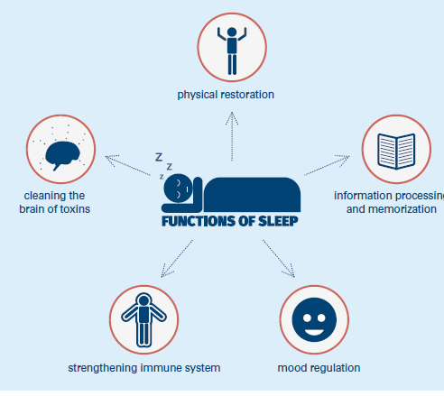
INTRODUCTION
Humans experience a wide range of physical, emotional, and behavioral changes when their circadian rhythm—the internal biological clock that regulates sleep-wake cycles—is disrupted. These disruptions can manifest as symptoms such as poor sleep quality, mood swings, fatigue, irritability, and a general decline in mental and emotional well-being. While these symptoms are often noticeable, they are frequently overlooked or misunderstood, especially in the fast-paced routines of daily life.
Manually tracking changes in mood, sleep, and daily habits is not only time-consuming but also prone to human error and inconsistency. In such cases, individuals may fail to recognize the early warning signs of deeper mental or physical health issues, allowing the imbalance to worsen over time. To address this growing concern, there is a pressing need to integrate technology into personal health monitoring in an intelligent and efficient manner.
By leveraging machine learning algorithms and the concept of cybernetic health, we can develop a smart system that analyzes user inputs such as sleep patterns, emotional states, stress levels, and lifestyle habits. This system, called RhythmRestore, is designed to detect patterns indicating circadian disruptions and provide timely, personalized guidance to help users correct these imbalances.
Through this approach, individuals are empowered to take preventive measures before their mental and emotional health deteriorates. The model not only enhances self-awareness but also promotes a balanced lifestyle, better sleep, and improved overall wellness through intelligent, tech-driven support

Slide 6
EXISTING SYSTEM
Circadian Rhythms, Sleep Deprivation, and Human Performance: This paper explores the effects of sleep homeostasis and circadian rhythms on brain metabolism and performance. Understanding these interactions can help in developing algorithms that consider both sleep quality and cognitive performance.
Personal Recommendation System for Improving Sleep Quality: This study discusses using long-term monitoring of vital data through body sensors and mobile applications to estimate sleep quality and provide real-time recommendations. It employs machine learning and big data analysis techniques, which could be instrumental for your recommendation engine
Personalized User Modelling for Context-Aware Lifestyle Recommendations to Improve Sleep: This research focuses on creating personalized sleep models by analysing the causal relationships between daily activities (exercise, eating habits, circadian rhythms) and sleep quality. Using N-of-1 experiments and event mining on longitudinal user data, the model identifies patterns and generates context-aware lifestyle recommendations. It employs a causal framework to filter out confounding variables, providing individualized feedback to optimize sleep outcomes. This approach could enhance the personalization and accuracy of your recommendation engine

Slide 7
PROPOSED SYSTEM
The proposed system, RhythmRestore, is a freshly built, AI-powered recommendation engine designed to promote circadian balance and support sleep wellness through personalized lifestyle guidance. RhythmRestore collects user inputs via a mobile-friendly web interface, gathering data on sleep duration, mood fluctuations, daily stressors, skipped meals, overwork, and social interactions. These inputs are intelligently analyzed to detect patterns that could disrupt the body’s natural sleep-wake cycle.
Utilizing a combination of rule-based logic and smart recommendation algorithms, RhythmRestore provides actionable, doctor-validated strategies such as dietary advice, stress-relief techniques, meditation routines, screen-time control, and other scientifically grounded practices aimed at improving sleep quality and circadian health. The recommendations are thoughtfully tailored to be affordable, culturally relevant to the Indian context, and easy to adopt in everyday life.
A key feature that enhances user engagement is the SMS notification system, which proactively sends personalized lifestyle recommendations directly to the user’s mobile device. This ensures users receive timely advice even when they are not actively using the web application, supporting consistent behavioral change.
What makes RhythmRestore stand out is its integration of cybernetic health principles, creating a feedback-informed system that empowers users to cultivate greater self-awareness and practice proactive behavioral tuning—without relying on real-time biofeedback devices. This sustainable, user-driven model positions RhythmRestore as a next-generation solution for fostering mental wellness and sleep hygiene through technology and mindful living.

Slide 8
APPLICATIONS
Hospitals & Mental Health Clinics
Workplace Wellness Programs
Educational Institutions
Rehabilitation Centers
Telehealth & Online Therapy Platforms
Elder Care & Assisted Living Facilities
Military and Emergency Services
Fitness & Wellness Apps

Slide 9
HARDWARE AND SOFTWARE REQUIREMENTS
Software Requirements:
Python 3.8+
Flask Framework
SQLite Database
HTML, CSS, Bootstrap (Frontend)
pandas, scikit-learn (for data handling and recommendation model)
Additional Features:
SMS functionality integrated via third-party API (like Twilio)
Hardware Requirements:
Standard Laptop or Desktop
Minimum 4GB RAM
Internet Browser (Google Chrome, Mozilla Firefox, Safari)

Slide 10
LITERATURE SURVEY
Author Names, Year | Journal / Conference Name & Publisher | Methodology / Algorithms Used | Merits | Demerits | Research Gaps
[1]C. della Monica et al., 2024 | Clocks & Sleep, vol. 6, no. 1, pp. 129-155 | Digital Technology for Monitoring Sleep, Circadian Rhythms, Sleep/Wake Cycles | Comprehensive protocol for monitoring sleep and circadian rhythms, focus on older people and those with dementia | Limited to specific population groups (older people, dementia patients) | Need for more inclusive data for different age groups and conditions, better integration with other devices
[2]F. Wu et al., 2024 | arXiv preprint, doi: 2404.03408 | Wearable Devices for Circadian Rhythm Monitoring (Activity, Heart Rate, Core Body Temperature) | Comparative analysis of commercial wearables, shows efficacy in circadian rhythm monitoring | High dependency on wearable devices, limited flexibility in non-wearable solutions | Lack of deep integration with existing health systems and non-wearable options, need for more personalized recommendations
[3]A. Nguyen et al., 2022 | arXiv preprint, doi: 2211.02592 | Real-time Acoustic Stimulation for Sleep Improvement, Closed-loop System | Personalized real-time sleep improvement using closed-loop acoustic stimulation | Requires continuous monitoring, may not suit all users | More personalized intervention options based on mood, need for cross-application integration with sleep data
[4]S. Rostaminia et al., 2021 | arXiv preprint, doi: 2106.07645 | Brain Activity & Physiological Signal Sensing (All-textile Eye Mask) | Innovative all-textile mask for non-invasive sleep monitoring, robust sensing of brain activity | May be uncomfortable for extended use, limited availability of similar devices | Need for more research on long-term usability and comfort, lack of integration with real-time feedback systems for personalized sleep improvement

Slide 11
PROBLEM STATEMENT
In today’s fast-paced world, many individuals experience disrupted sleep cycles, irregular routines, and heightened stress levels due to various lifestyle factors such as overwork, skipped meals, excessive screen time, and negative emotional triggers. These disruptions often go unnoticed until they manifest as serious mental or physical health issues, including fatigue, anxiety, poor concentration, or dissociative symptoms. Traditional health systems rely on self-awareness or medical intervention, which may be delayed, inconsistent, or inaccessible to many individuals—especially in high-pressure environments or underserved communities.
There is a clear need for an intelligent system that can proactively identify behavioral patterns leading to circadian rhythm imbalance and offer timely, actionable guidance. RhythmRestore addresses this need by providing an AI-driven recommendation system that analyzes user-reported lifestyle inputs to generate personalized suggestions aimed at restoring healthy sleep-wake cycles. The system bypasses the need for expensive wearables or real-time biofeedback and instead uses accessible data like mood, sleep duration, daily stressors, and social triggers to assess risk and suggest improvements.
Furthermore, many individuals struggling with sleep or mental fatigue may not recognize the root cause of their symptoms or may lack the tools to act on them effectively. RhythmRestore empowers users by creating a structured, self-reflective, and behavior-oriented feedback loop that encourages sustainable well-being through small but impactful daily changes.

Slide 12
OBJECTIVES
Improve sleep quality and manage sleep disorders through personalized, actionable recommendations delivered via web and SMS notifications.
Apply cybernetic health principles to dynamically adapt based on user behavior and lifestyle patterns.
Deliver tailored interventions that align with individual lifestyle habits, mood states, and stress levels.
Enable continuous learning within the system to refine and enhance recommendations over time through feedback.
Send personalized health tips via SMS, ensuring users receive timely guidance even without opening the app.

Slide 13
MODULES
User Input Collection Module Collects daily user data through a simple form-based interface.
2. Preprocessing & Pattern Recognition Module Cleans and organizes the input data for analysis.
3. Recommendation Generation Module Uses predefined logic and behavioral health insights to generate customized suggestions.
4. Cybernetic Health Monitoring Module Implements feedback loops to improve decision-making based on past behavior.

Slide 14
ALGORITHM
In this project, we use a Rule-Based Prediction and Simple Machine Learning (Decision Tree) method instead of complex deep learning networks. Our system is lightweight and fast, making it ideal for analyzing daily behavioral patterns (sleep, mood, stress, meals) to provide actionable, easy-to-follow recommendations without needing wearables or sensors.
The flow integrates user input, pattern recognition, recommendation generation, and progress monitoring through a gamified feedback system.

Slide 15
1. Input Layer
The input layer collects daily lifestyle features:
Sleep Time
Wake Time
Meals Skipped (Yes/No/Sometimes)
Stress Level (1-5 Scale)
Mood (Happy, Neutral, Sad, Anxious)
Traffic Exposure (Yes/No)
Screen Time (in hours)
Preprocessing tasks:
Sleep Duration:
Calculated as the difference between Wake Time and Sleep Time (in hours).
Label Encoding: Categorical inputs (Mood, Traffic, Meals Skipped) are encoded into numeric format.
Missing Values Handling: Default values filled for any missing or empty fields.

Slide 16
2. Hidden Layer: Pattern Recognition and Recommendation
The hidden layer is where intelligent prediction happens:
Modeling:
Decision Tree Classifiers are trained for four categories:
Diet Recommendation
Workout Recommendation
Sleep Habit Recommendation
Stress Relief Recommendation
Features for Models:
Sleep Duration
Meals Skipped
Stress Level
Mood
Traffic Exposure
Screen Time

Slide 17
3. Feedback Layer (Cybernetic Monitoring)
After recommendations:
User provides daily feedback:
"Did your sleep improve today?" (Yes/No)
"Did you follow your diet today?" (Yes/No)
Reward System:
1 Star if sleep improved.
1 Star if diet was followed.
Daily feedback is stored in SQLite Database for tracking.
4. Output Layer: Gamification and Visualization
Recommendations Display:
Personalized tips shown immediately after submission.
Star Collection (Gamification):
Stars earned are visualized by filling a star jar.
Each day’s performance is recorded.
Weekly Progress Visualization:
Shows Sleep Hours, Stress Level, and Total Stars Earned for the last 7 days.
Progress Cards and Trend Summary to motivate user.

Slide 18
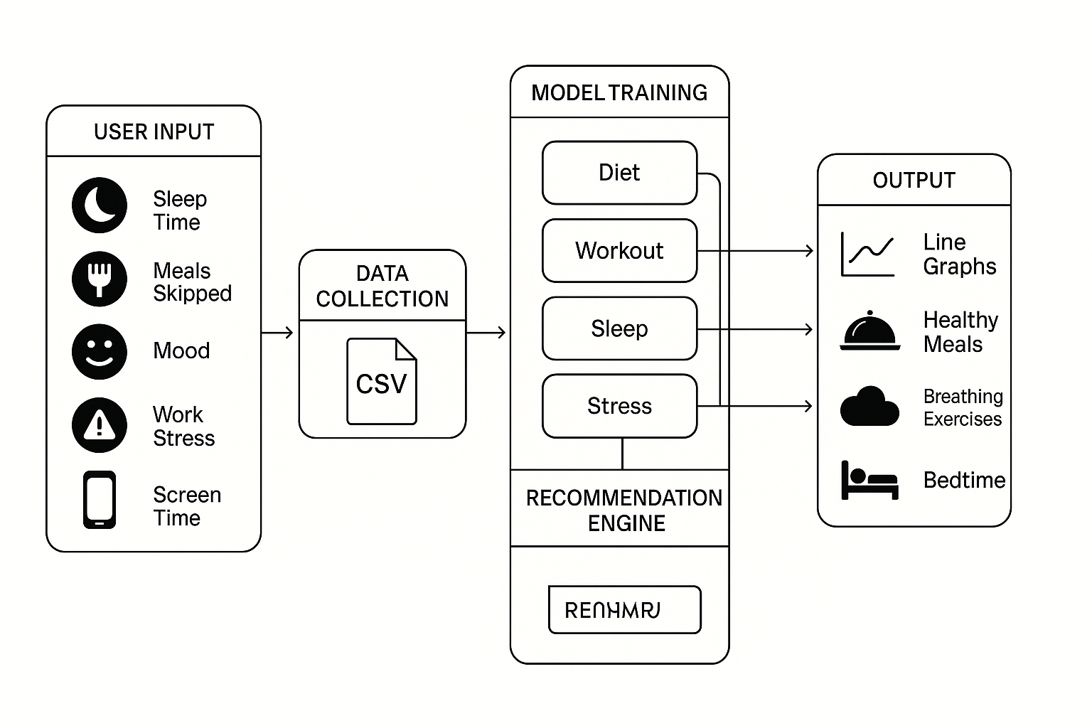
ARCHITECTURE

Slide 19
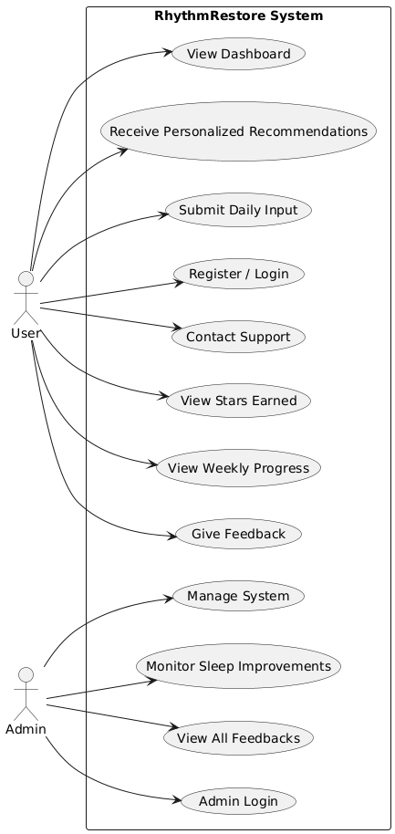
USE CASE DIAGRAM

Slide 20
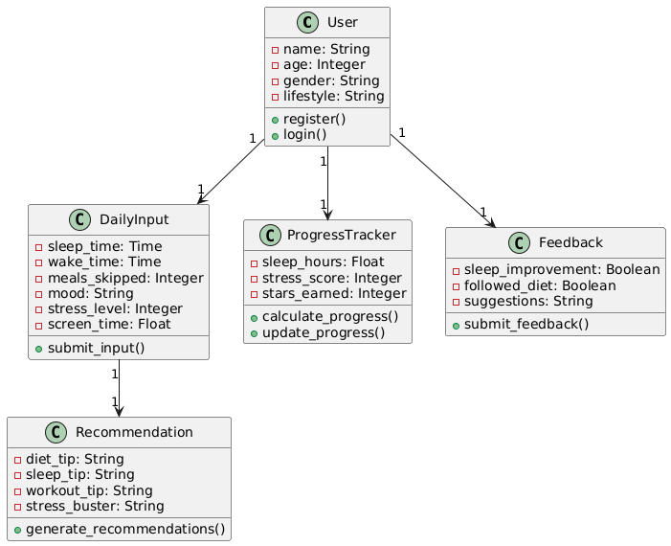
CLASS DIAGRAM

Slide 21
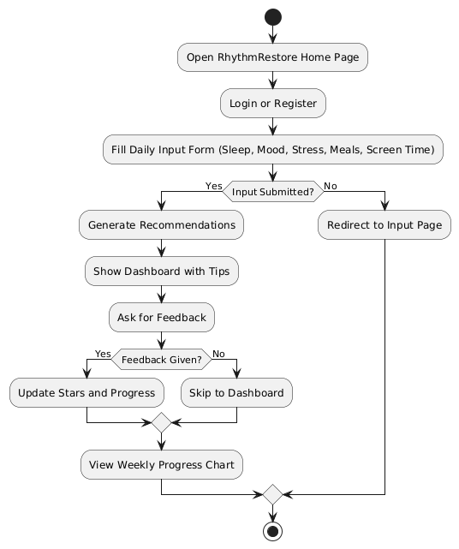
ACTIVITY DIAGRAM

Slide 22
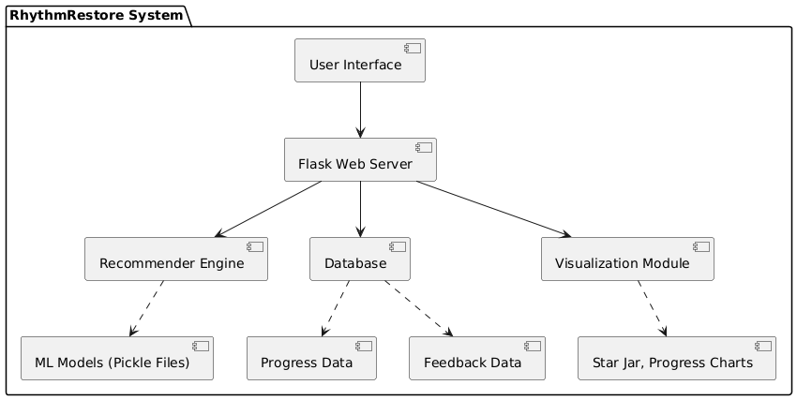
COMPONENT DIAGRAM

Slide 23
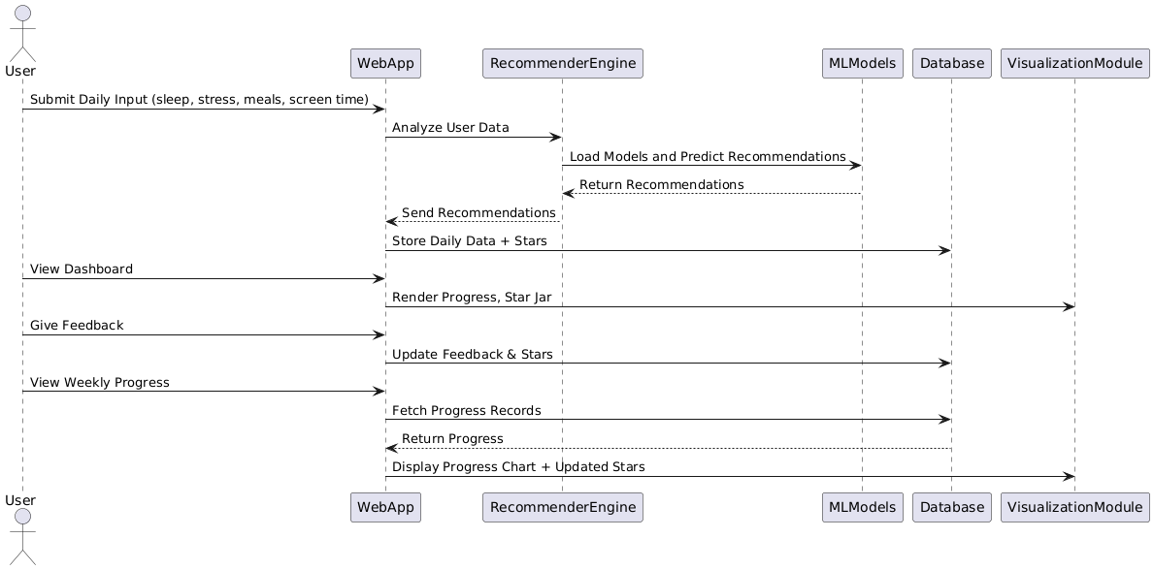
SEQUENCE DIAGRAM

Slide 24
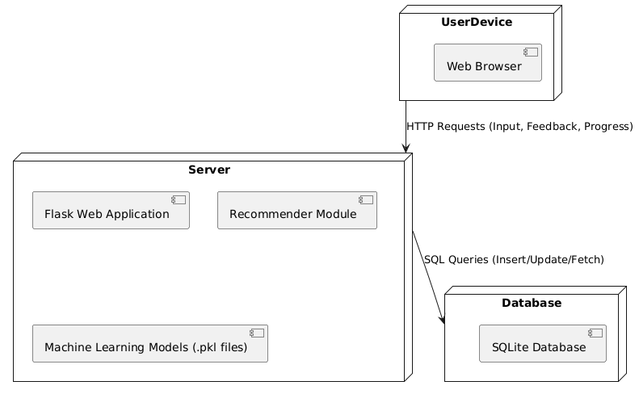
DEPLOYMENT DIAGRAM

Slide 25
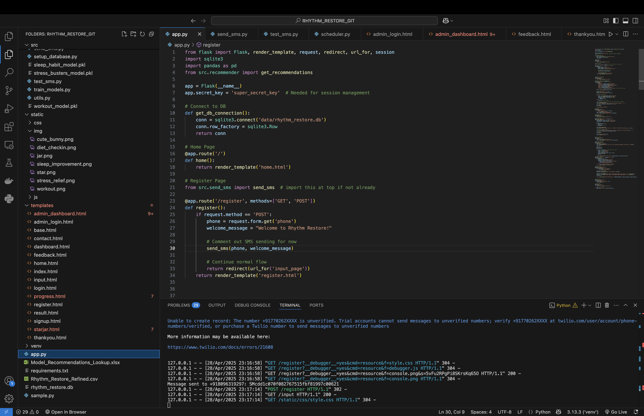
CODE IMPLEMENTATION AND OUTPTS:

Slide 26
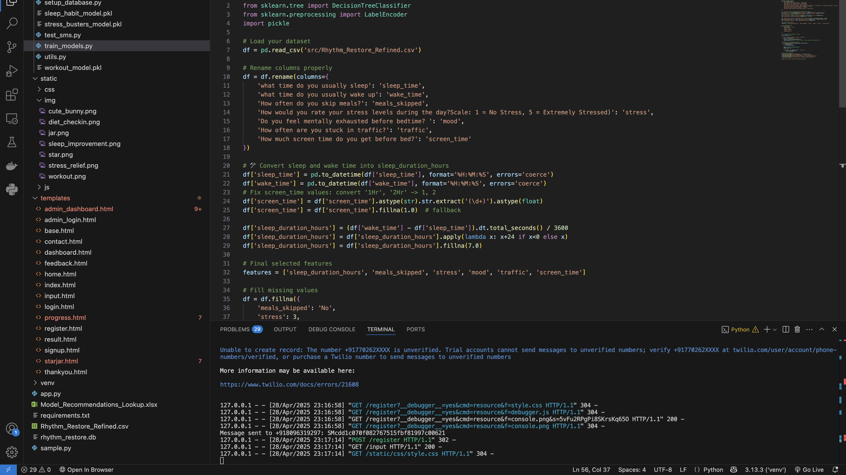

Slide 27
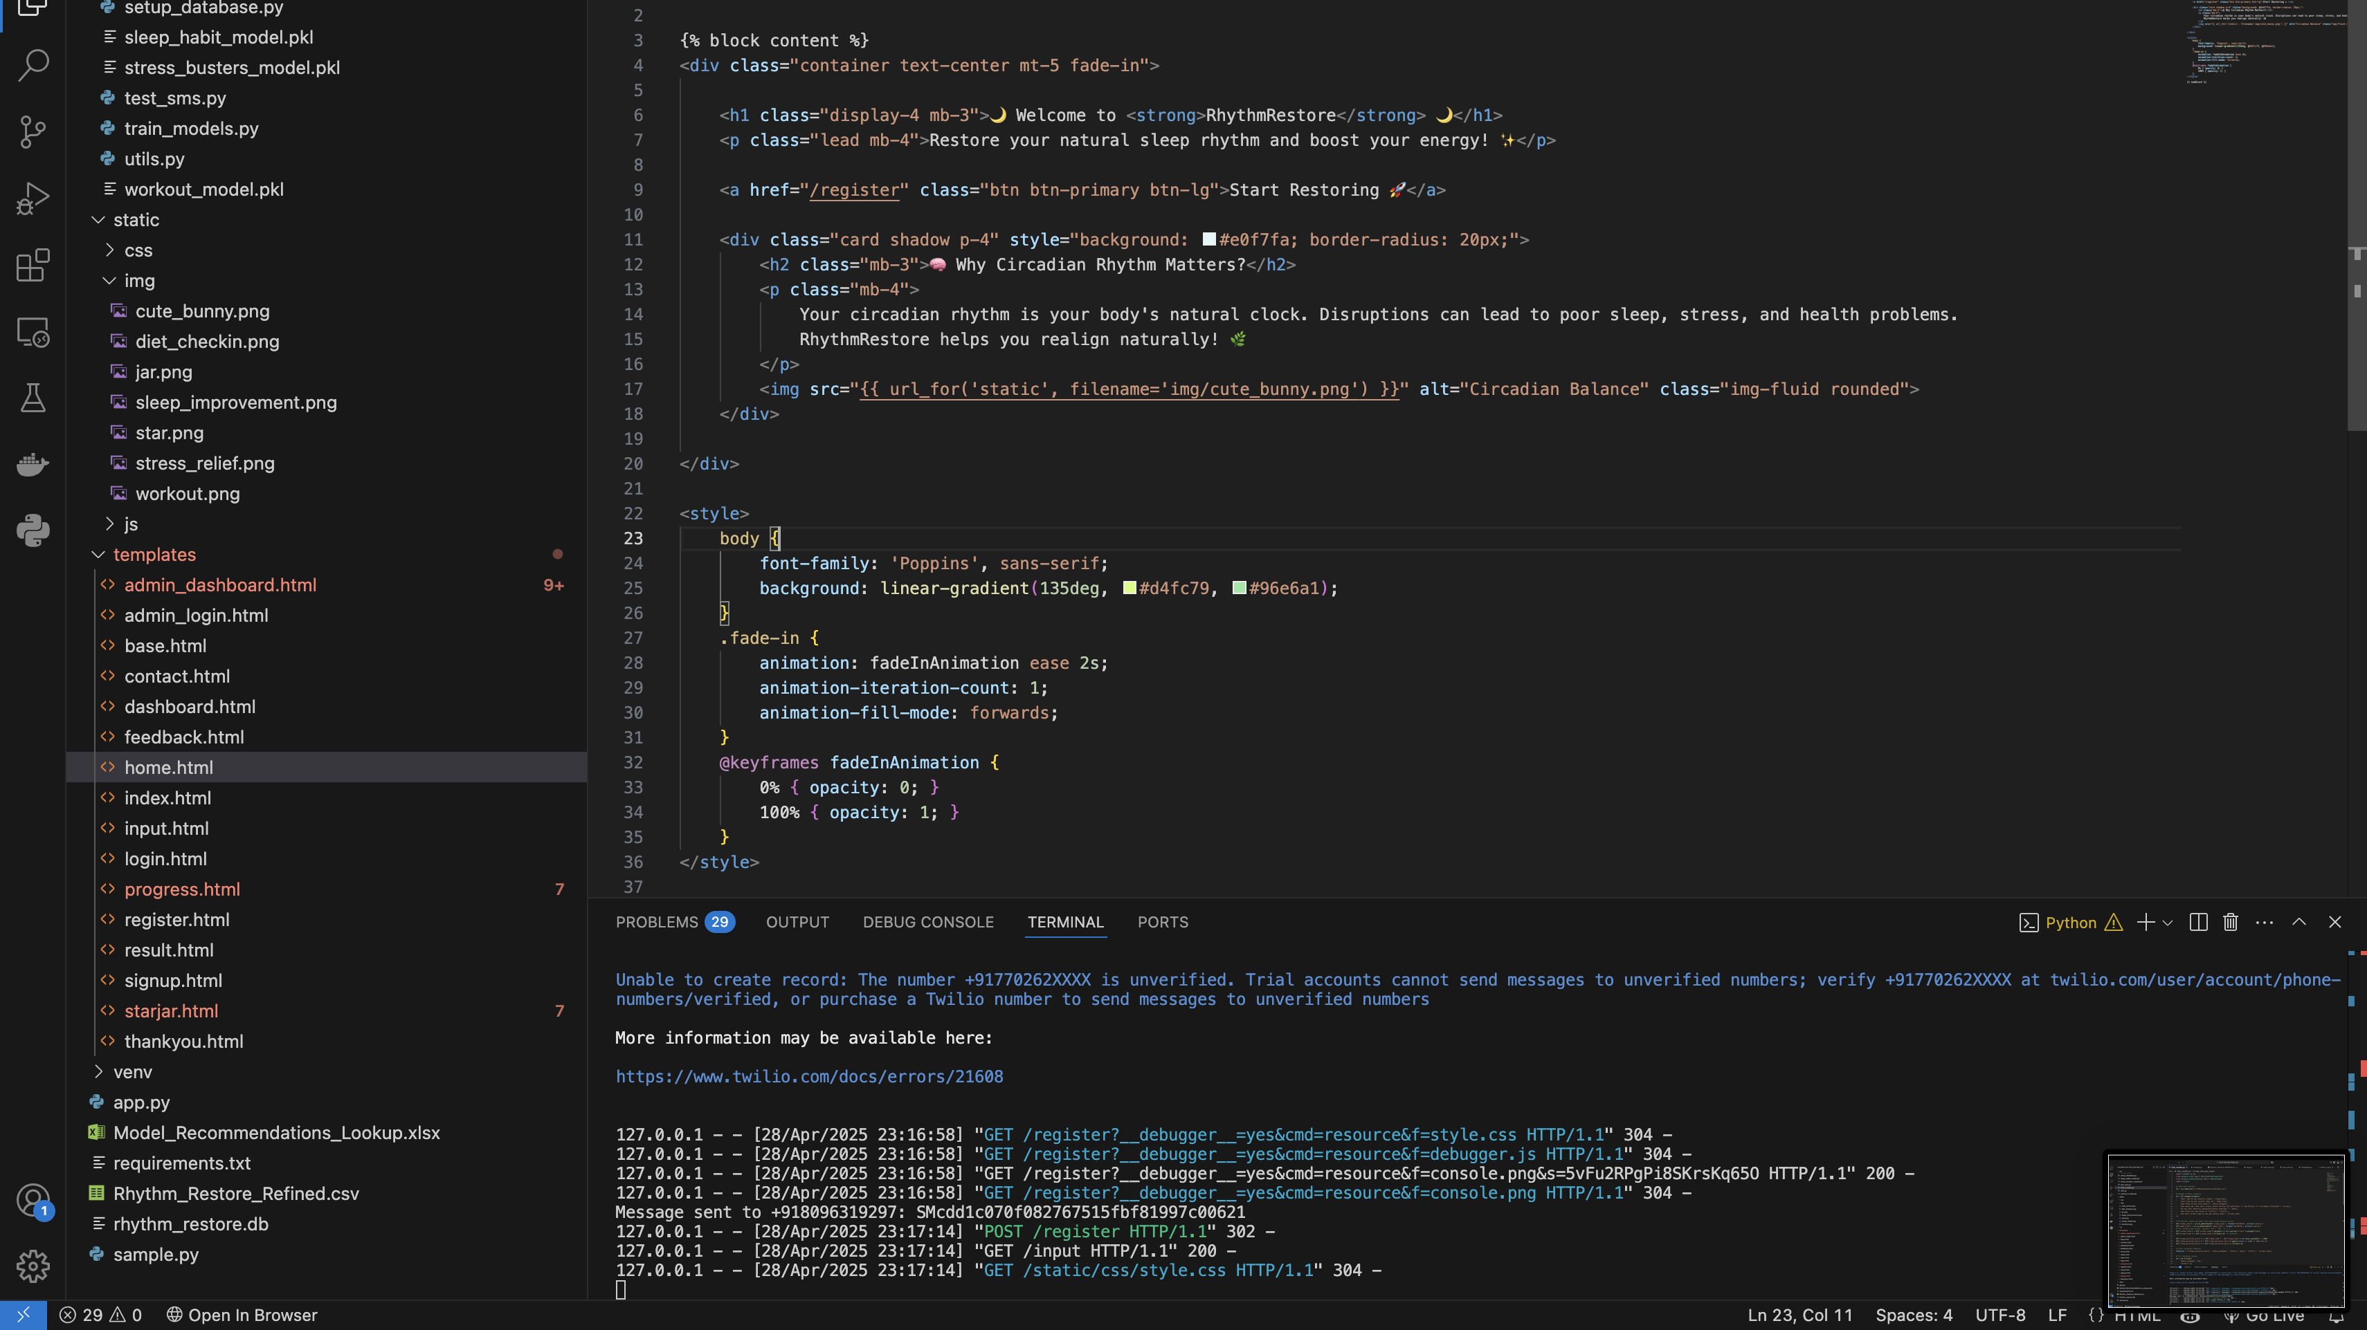

Slide 28
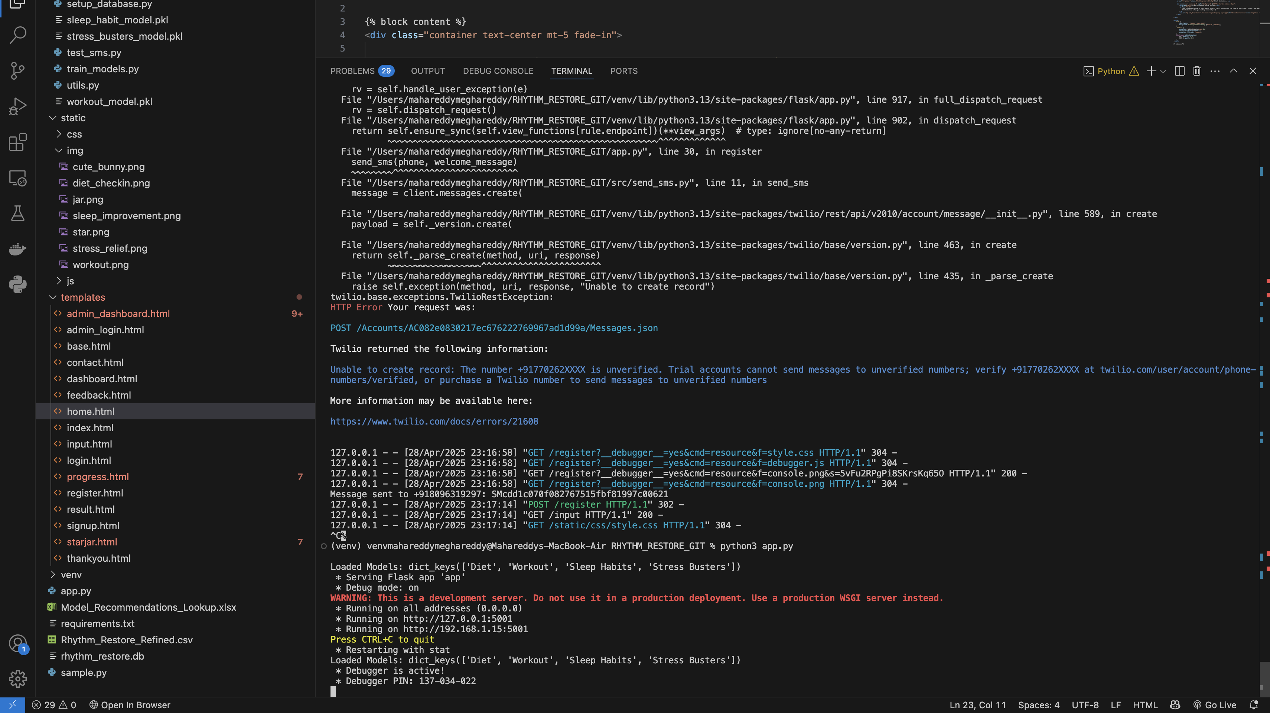

Slide 29
TEST CASES
S. No | Test Case Name | Input | Expected Output | Actual Output | Remarks
1 | Submit Sleep & Mood Data | Sleep time, Mood level | Data saved and passed to recommendation engine | Data saved and passed to recommendation engine | Pass
2 | Trigger Diet Recommendation | Meals skipped = Yes | Displays healthy meal tips | Displays healthy meal tips | Pass
3 | View Graphical Progress | None | Shows line chart for sleep and stress over last 7 days | Shows line chart for sleep and stress over last 7 days | Pass
4 | Workout Recommendation Trigger | Screen time > 3 hrs | Displays workout suggestions | Displays workout suggestions | Pass
5 | Breathing Tips for Stress | Work stress = High | Suggests breathing exercises | Suggests breathing exercises | Pass
6 | Access Recommendation Summary | None | Redirects to /Summary and displays all categories | Redirects to /Summary and displays all categories | Pass

Slide 30
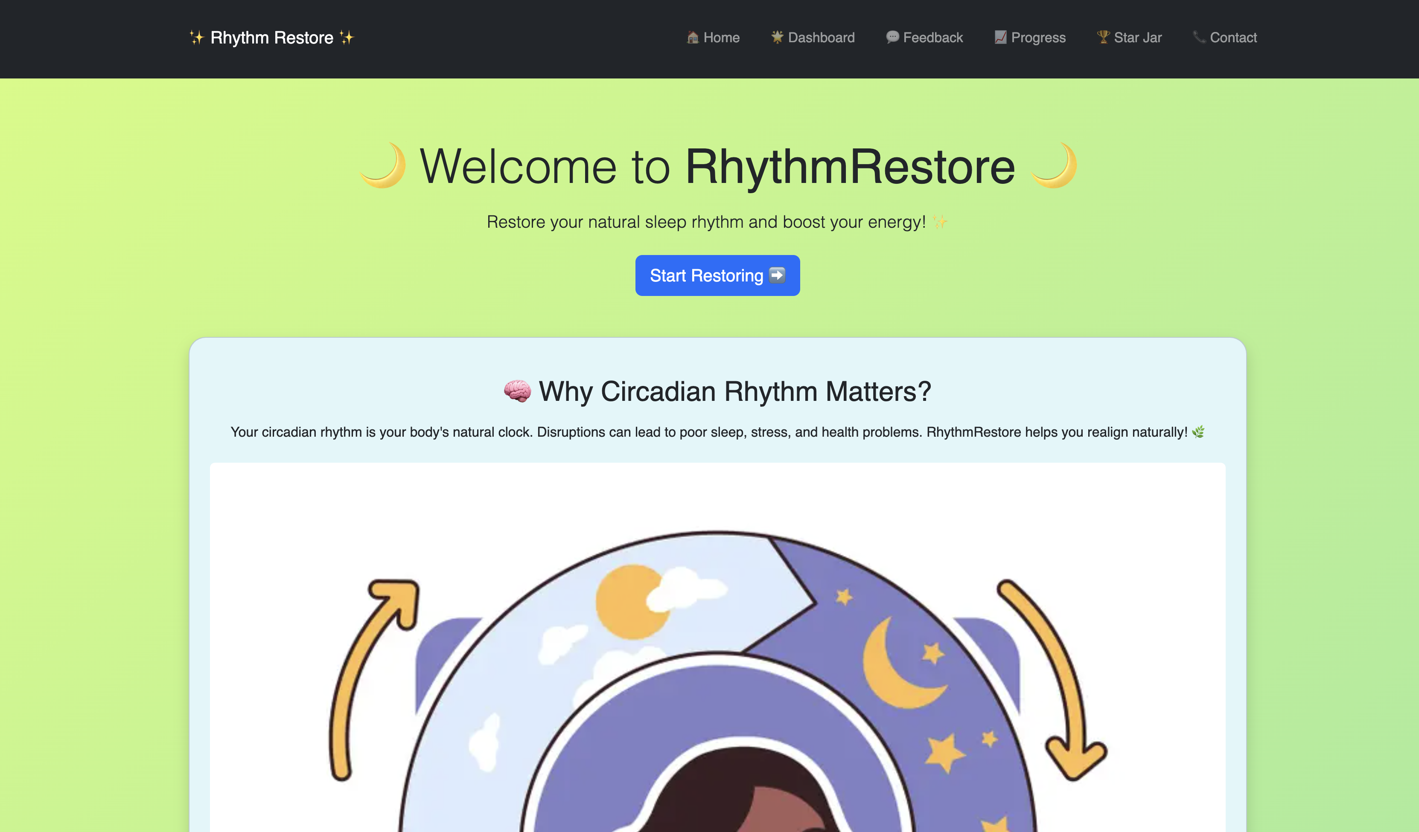

Slide 31
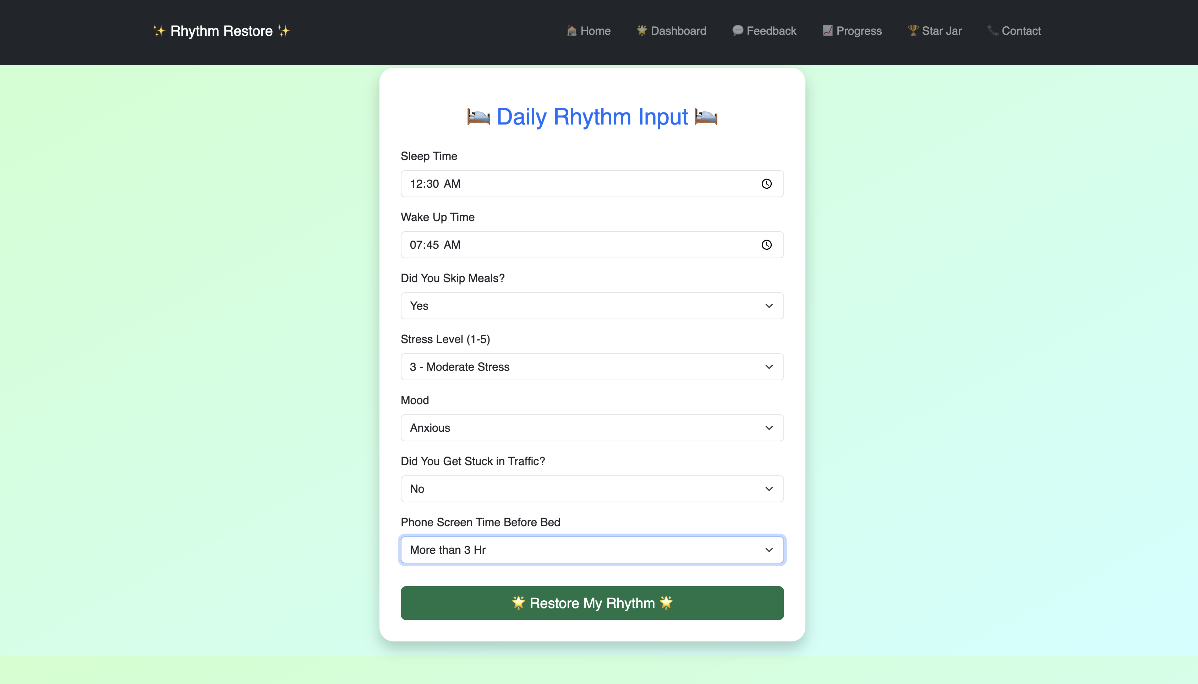

Slide 32
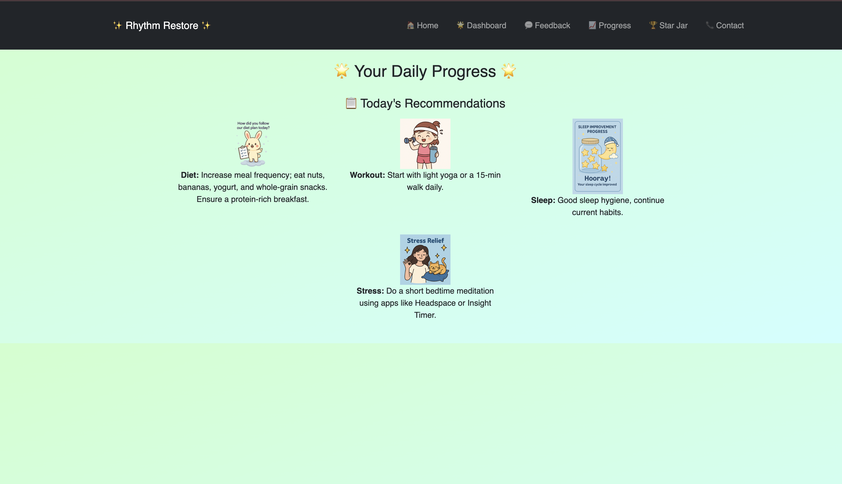

Slide 33
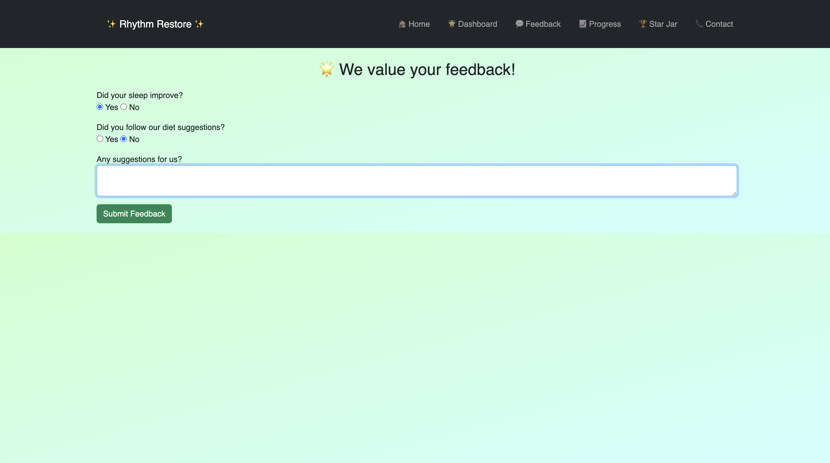

Slide 34
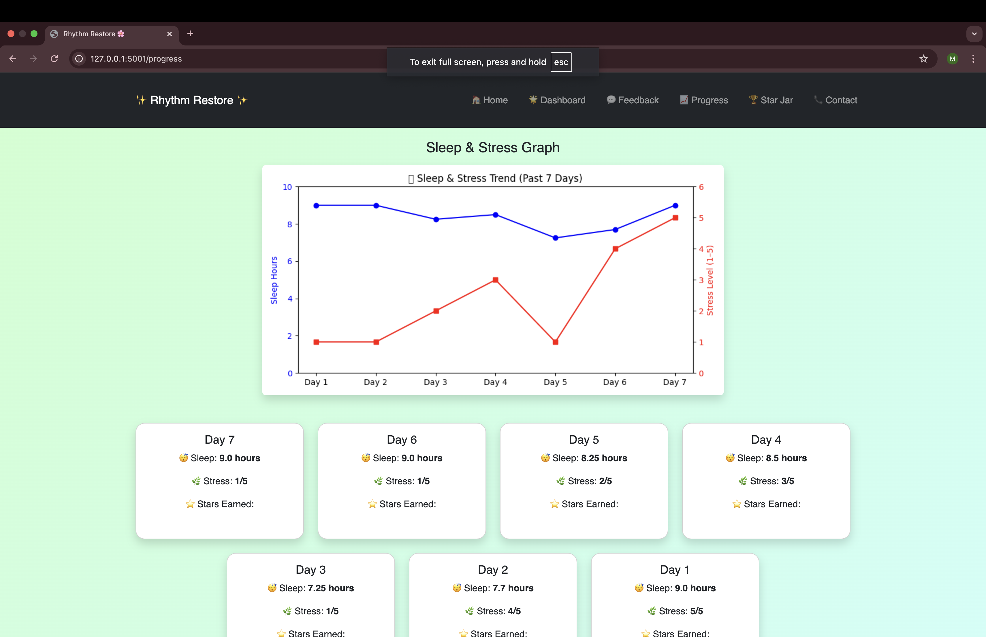

Slide 35
CONCLUSION AND FUTURE ENHANCEMENT
RhythmRestore successfully provides a simple, smart, and engaging platform to help users monitor and improve their sleep, stress, and daily habits.
By using daily behavioral inputs and personalized recommendations, the system empowers users to identify unhealthy patterns early and make small but impactful lifestyle changes..
The project achieves its goal of combining mental wellness guidance with interactive design, offering a positive, supportive, and habit-building tool without the need for expensive wearables or medical interventions.
Through continuous user engagement, RhythmRestore helps individuals move towards a healthier circadian rhythm and overall better well-being.

Slide 36
Future Enhancements
Mobile Application Development: Build Android and iOS apps for easier daily tracking and notifications.
Device Integration: Connect with fitness trackers and smartwatches to automatically collect real-time sleep and activity data.
AI and Predictive Analytics: Implement deep learning models (e.g., Recurrent Neural Networks) to predict sleep disruption patterns based on lifestyle behaviors.
Behavioral Analytics Dashboard: Provide detailed, visually appealing trend analysis over months (not just 7 days).
Mood and Emotional Wellness Monitoring: Add modules for journaling and emotional tracking for deeper mental health support.
Reminders and Alerts: Push personalized notifications if users’ behavior indicates rising stress or declining sleep quality.
Community Features: Add gamified community challenges and wellness groups to encourage group motivation.
Localization and Accessibility: Support multiple languages and make the platform accessible to users with disabilities.

Slide 37
REFERENCES
[1]C. della Monica et al., 2024. "A Protocol for Evaluating Digital Technology for Monitoring Sleep and Circadian Rhythms in Older People and People Living with Dementia in the Community," Clocks & Sleep, vol. 6, no. 1, pp. 129-155, 2024, doi: 10.3390/clockssleep6010010.
[2]F. Wu et al., 2024. "Comparative Efficacy of Commercial Wearables for Circadian Rhythm Home Monitoring from Activity, Heart Rate, and Core Body Temperature," arXiv preprint, doi: 2404.03408, 2024.
[3]A. Nguyen et al., 2022. "A Large-Scale Study of a Sleep Tracking and Improving Device with Closed-loop and Personalized Real-time Acoustic Stimulation," arXiv preprint, doi: 2211.02592, 2022.
[4]S. Rostaminia et al., 2021. "PhyMask: Robust Sensing of Brain Activity and Physiological Signals During Sleep with an All-textile Eye Mask," arXiv preprint, doi: 2106.07645, 2021
[5]S. H. Cho et al., 2023. "Wearable Devices for Monitoring Circadian Rhythms and Sleep Patterns: A Review," Journal of Biomedical Science and Engineering, vol. 16, no. 4, pp. 1-15, 2023, doi: 10.4236/jbise.2023.164005.
[6]D. S. Martinez et al., 2023. "Improvement of Sleep Quality through Smart Wearables: A Comparative Study of Devices," Sleep Health, vol. 9, no. 2, pp. 102-111, 2023, doi: 10.1016/j.sleh.2023.02.005.
[7]J. R. Lee et al., 2022. "Smartphone-based Sleep Tracking and Its Impact on Sleep Improvement: A Review of Current Solutions," Computers in Biology and Medicine, vol. 148, pp. 1058-1065, 2022, doi: 10.1016/j.compbiomed.2022.1058.

Slide 38
THANK YOU

